Slide 1

WithU
The SAFEwalk Alternative

Slide 2

Problem
The current SAFEwalk model is inefficient
Hours end at 1 am
Students have to call and request a safewalk and state their location (instead of a GPS knowing exactly where they are).
Safety issues with Uber drivers due to inadequate background checks
Surge pricing with Uber can be extremely costly
Notes:
https://www.yahoo.com/gma/lawsuit-female-uber-passengers-endured-rape-physical-violence-011406810--abc-news-topstories.html
https://www.yahoo.com/gma/lawsuit-female-uber-passengers-endured-rape-physical-violence-011406810--abc-news-topstories.html
Current SAFEwalk
Student-run
SAFEwalk Hours – 7 p.m. – 1 a.m. October – March; 8 p.m. – 1 a.m. April – September

Slide 3

Solution
Smartphone app that simplifies the process of requesting a walk home
User-friendly Interface
Utilize GPS-enabled location technology
Later hours to accommodate student activities
Two walkers will walk you home
One male, one female
Notes:
Include contacts and information for safety and security resources at the university
What to do in various emergency situations
Referral options for sexual harassment/assault
Contact information of university police, etc.
Quick access to emergency calls
Allow users to quickly summon help from 911 with the tap of a button

Slide 4
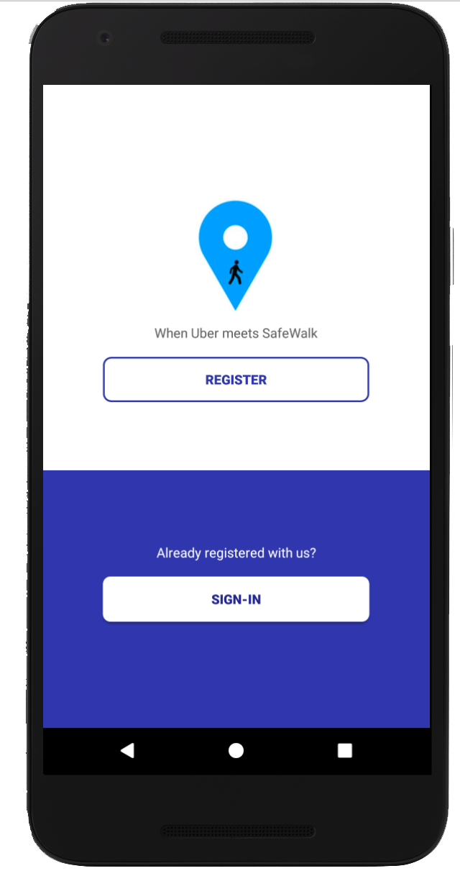
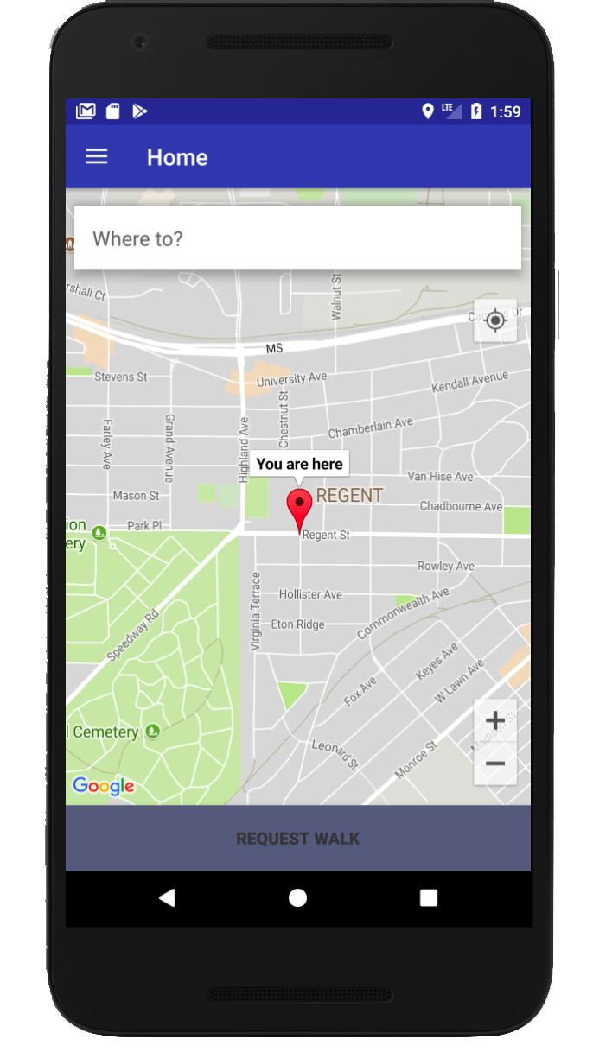
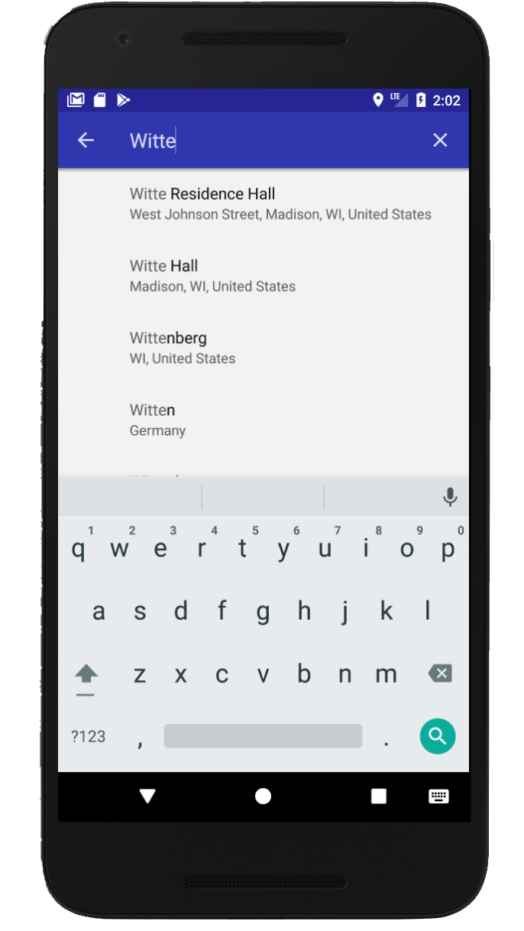
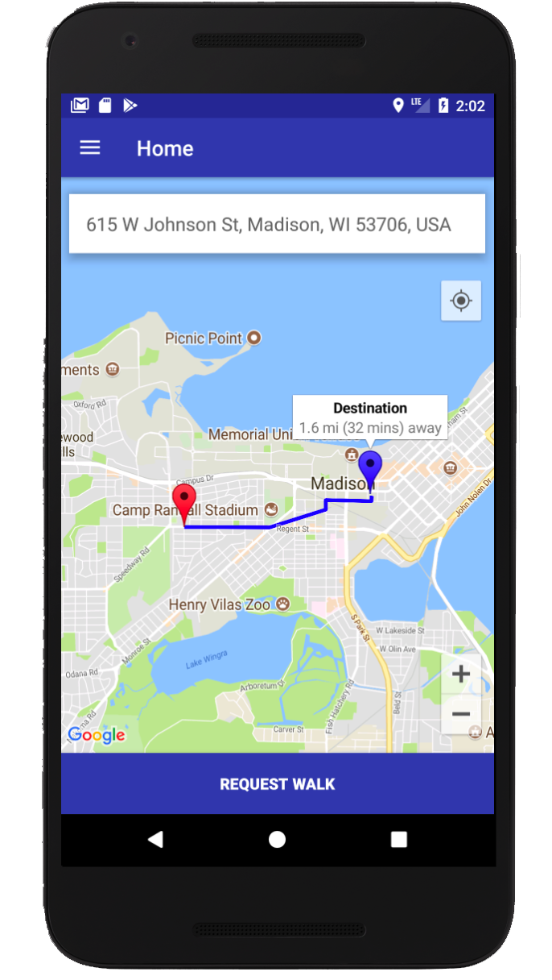
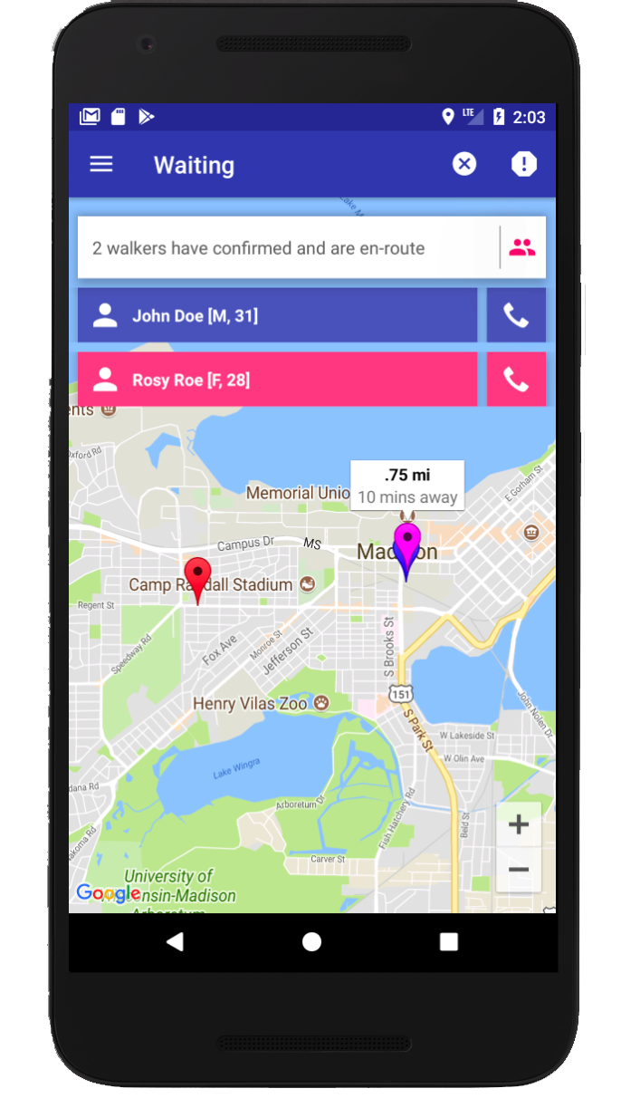
Product
Notes:
This slide shows actual screenshots from the application that is currently under development. The first screenshot shows the registration and sign in screen, and the last four show the process of requesting a walk. When designing the interface and the flow of the application, we wanted to keep the process for requesting a walk as simple as possible. You can see in the first slide that the application tracks your current location, and when you click on the “Where to?” field, you can either specify an address or search for a landmark like Witte Hall. The app then draws the path to your destination. When you hit “Request Walk” in a matter of seconds there should be walkers on their way to your location.

Slide 5
Functional Features
Account Registration
Log In / Log Out
Switch to Walker
Create Walk
Destination Navigation
Call Walkers
Rate Walk
Notes:
We want to focus on Madison first, but their is an opportunity to expand our program to other universities
Colleges that currently don't have an app and use personal phone calls to track location
BYU
Michigan State
Majority of UW schools
Millennials
Mostly familiar with digital and social media platforms
More efficient than current SAFEwalk service offered

Slide 6

In Progress & Future Features
Walker Pairing
Matching Pair to Requested Walk
Navigation for Pair to Meet
Future
In-app messaging between walkers and user
Improve matching system to match with closest pair
Adding pictures to profile

Slide 7
Challenges
Event-Based Architecture
Google Maps API
Concurrency
Google Maps doesn’t make it easy to build paths on the map
Pass back individual map points and you have to “draw” connections between the points
Google Places API simplified the creation of a destination
One of the major challenges with trying to create the pairing and walk matching services was scalability and dealing with concurrent access to fields in the DB
Much of our application flow depends on data changes coming from the database
Our backend had to enable and disable listeners on specific DB locations at different times
Notes:
New media (social media):
Target millennials
Mostly familiar with digital and social media platforms

Slide 8



Marketing & Adoption
Market towards universities that want to increase campus safety
These Universities could pay us to license the app
If universities are not willing to pay for the service, we could reach an agreement that we could replace their current program
Market towards parents of incoming freshman (Ex. present the app at SOAR)
Traditional media: dorm posters, newspaper ads
Social media: utilize university’s official sns accounts to appeal to a wider student body (millennials)
In order to achieve the network effect, we plan on teaming up with sororities to help push the product on college campuses
Notes:
New media (social media):
Target millennials
Mostly familiar with digital and social media platforms

Slide 9
Questions?

